Slide 1

random numbers concept
DURGARAJ KATWAL

Slide 2
Probability concept in simulation –stochastic variables :
stochastic variables
Ordered set of random values
Stochastic process give rise to stochastic variable
Stochastic process can be discrete or continuous

Slide 3
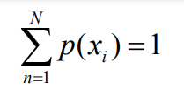
Discrete Probability Functions
Or Probability Mass Function (PMF)
Distribution of probabilities -If a variable can take n different values xn (n = 1, 2, 3, … N), and probability of xn being take is p(xn), then the set of numbers comprise of p(xn) is probability mass function
In certain cases like dice roll, the PMF values may be known (e.g. 1/6). But most of the time, PMF is counted from input sample

Slide 4
Random variables
The result from the experiment becomes a variable; that is, a quantity taking different values on different occasions. Because the experiment involves selection at random, we call it a random variable.
Example : Select items at random from a batch of size N until the first defective item is found. Record the number of non-defective items. Sample Space: S = {0, 1, 2, . . . , N}

Slide 5
Types of random variables
1. Discrete random variables :
Discrete random variables take on a countable number of distinct values. Consider an experiment where a coin is tossed three times. If X represents the number of times that the coin comes up heads, then X is a discrete random variable that can only have the values 0, 1, 2, or 3 (from no heads in three successive coin tosses to all heads). No other value is possible for X
For example, discrete random variables include the following
The number of heads that come up during a series of coin tosses.
The number of library books checked out per hour.

Slide 6
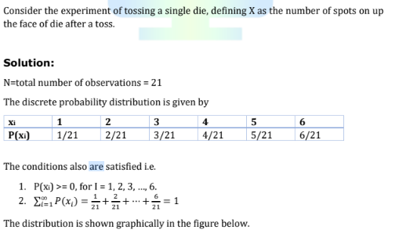
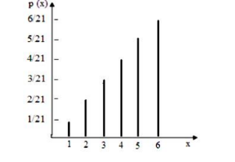

Slide 7
2. Continuous Random Variables
Continuous random variables can represent any value within a specified range or interval and can take on an infinite number of possible values. An example of a continuous random variable would be an experiment that involves measuring the amount of rainfall in a city over a year or the average height of a random group of 25 people.

Slide 8
This data type often occurs when you measure a quantity on a scale. For example, continuous random variables include the following:
Height and weight.
Time and duration.
Temperatures.
Analysts denote a continuous random variable as X and its possible values as x, just like the discrete version. However, unlike discrete random variables, the chances of X taking on a specific value for continuous data is zero. In other words: P (X = x) = 0, where x is any specific value.
Instead, probabilities greater than zero only exist for ranges of values, such as P(a ≤ X ≤ b), where a and b are the lower and upper bounds of the range
A probability density function (PDF) describes the probability distribution of a continuous random variable. These functions use a curve displaying probability densities, which are ranges of one unit.
Continuous random variables must satisfy the following:
Probabilities for all ranges of X are greater than or equal to zero: P(a ≤ X ≤ b) ≥ 0.
The total area under the curve equals one: P(-∞ ≤ X ≤ + ∞) = 1

Slide 9

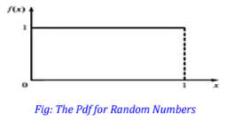

Properties of Random Numbers
A sequence of random numbers, R₁,R₂…..R_{n} must have two important properties:
1.uniformity, i.e. they are equally probable every where
2. independence, i.e. the current value of a random variable has no relation with the previous values
Each random number R_{i} is an independent sample drawn from a continuous uniform distribution between zero and one.
Pdf
Expectation

Slide 10

Properties of Random Numbers
Variance
Some consequences of the uniformity and independence properties
If the interval (0,1) is divided into n sub-intervals of equal length, the expected number of observations in each interval is N/n where N is the total number of observations. Note that N has to be sufficiently large to show this trend.
The probability of observing a value in a particular interval is independent of the previous values drawn.

Slide 11
Pseudo random numbers
"Pseudo" means false, so false random numbers are being generated. In this instance,"pseudo' is used to imply that the very act of generating random numbers by a known method removes the potential for true randomness.If the method is known,the set of random numbers can be replicated. Then an argument can be made that the numbers are not truly random. The goal of any generation scheme,however,is to produce a sequence of numbers between 0 and 1 that simulates, orimitates,the ideal properties of uniform distribution and independence as closely as possible.
To be sure, in the generation of pseudo-random numbers, certain problems or errors can occur.These errors, or departures from ideal randomness, are all related to the properties stated: previously. Some. examples of such departures include the following:
1. The generated numbers might not be uniformly distributed.
2.The generated numbers might be discrete-valued instead of continuous-valued,
3.The mean of tne generated numbers might be too high or too low.
4.The variance of the generated numbers might be too high or too low.

Slide 12
Generating Random Numbers
Midsquare method
Linear Congruential Method (LCM )
Combined Linear Congruential Generators (CLCG)
Random-Number Streams

Slide 13
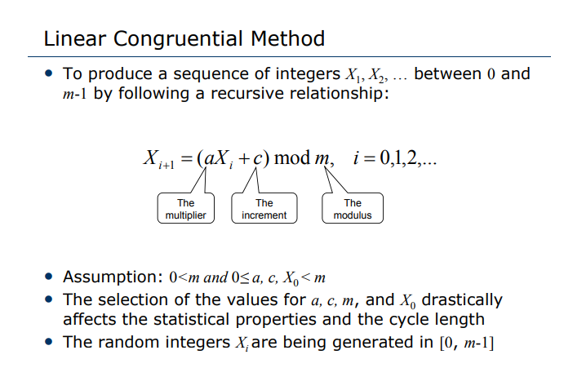

Slide 14
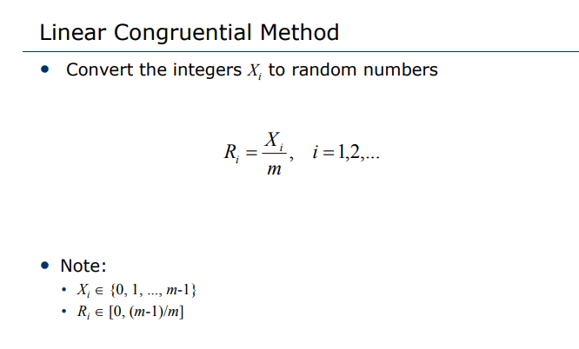

Slide 15
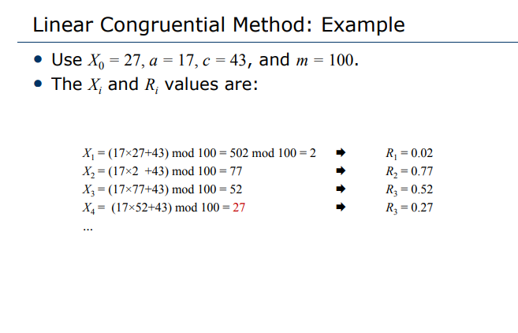

Slide 16
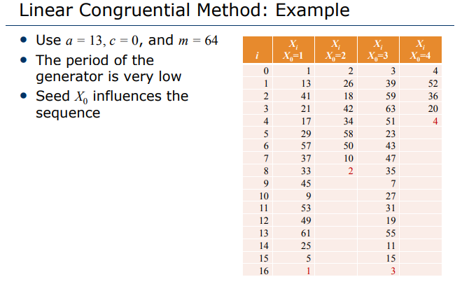

Slide 17
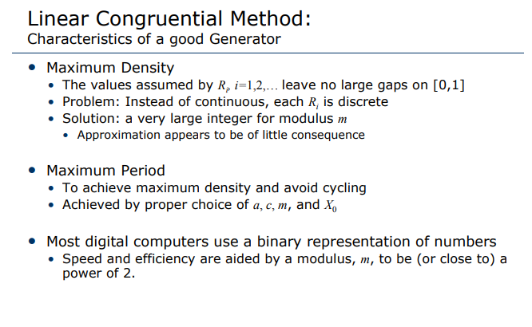

Slide 18
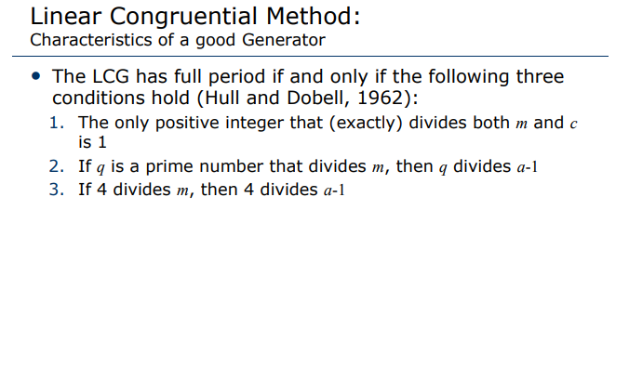

Slide 19
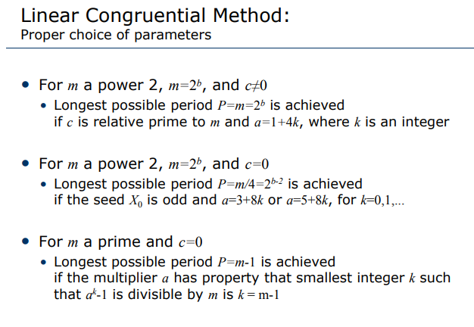

Slide 20
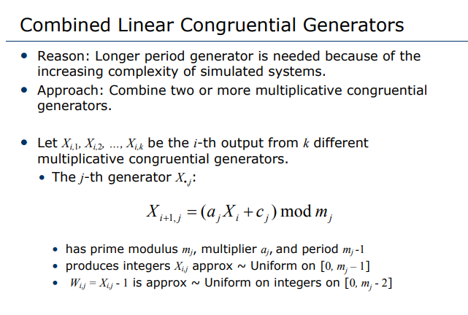

Slide 21
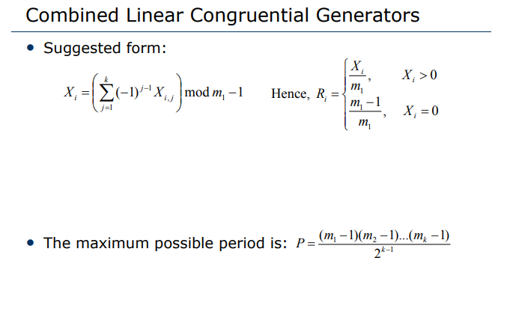

Slide 22
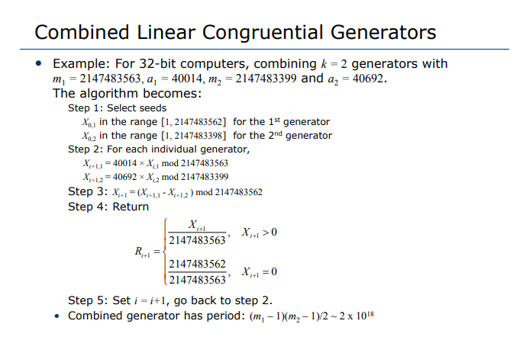

Slide 23
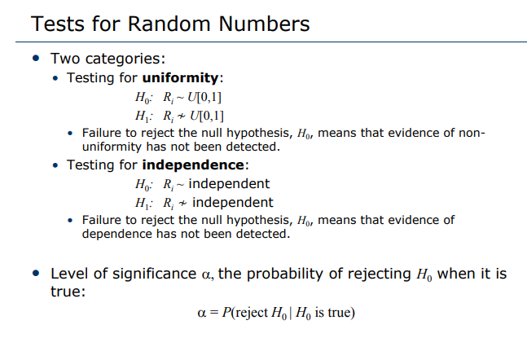

Slide 24
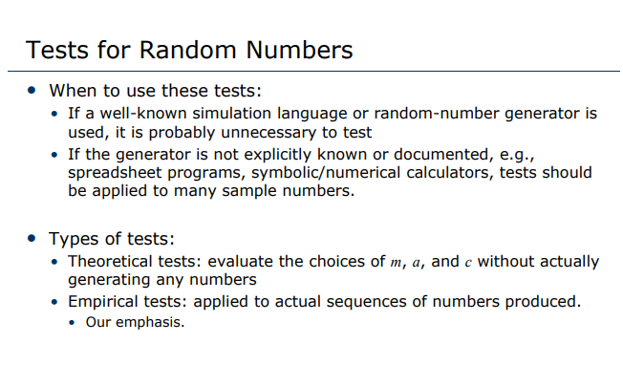

Slide 25
Test for Random numbers
1. Frequency test Frequency test. Uses the Kolmogorov Uses the Kolmogorov-Smirnov Smirnov or the chi-square test to compare the distribution of the set of numbers generated to a uniform di t ib ti distribution.
2. Runs test. Tests the runs up and down or the runs above and below the mean by comparing runs above and below the mean by comparing the actual values to expected values. The statistic for comparison is the chi-square.
3. Autocorrelation test. Tests are the correlation between numbers and compares the sample correlation to the exportation correlation zero.
4.Gap test Counts the number of digits that Counts the number of digits that appear between repetitions of a particular digit and then uses the Kolmogorov-Smirnov test to compare with the expected number of gaps.
5. Poker test. Treats numbers grouped together as a poker hand. Then the hands obtained are compared to what is expected using the chisquare test. .

Slide 26
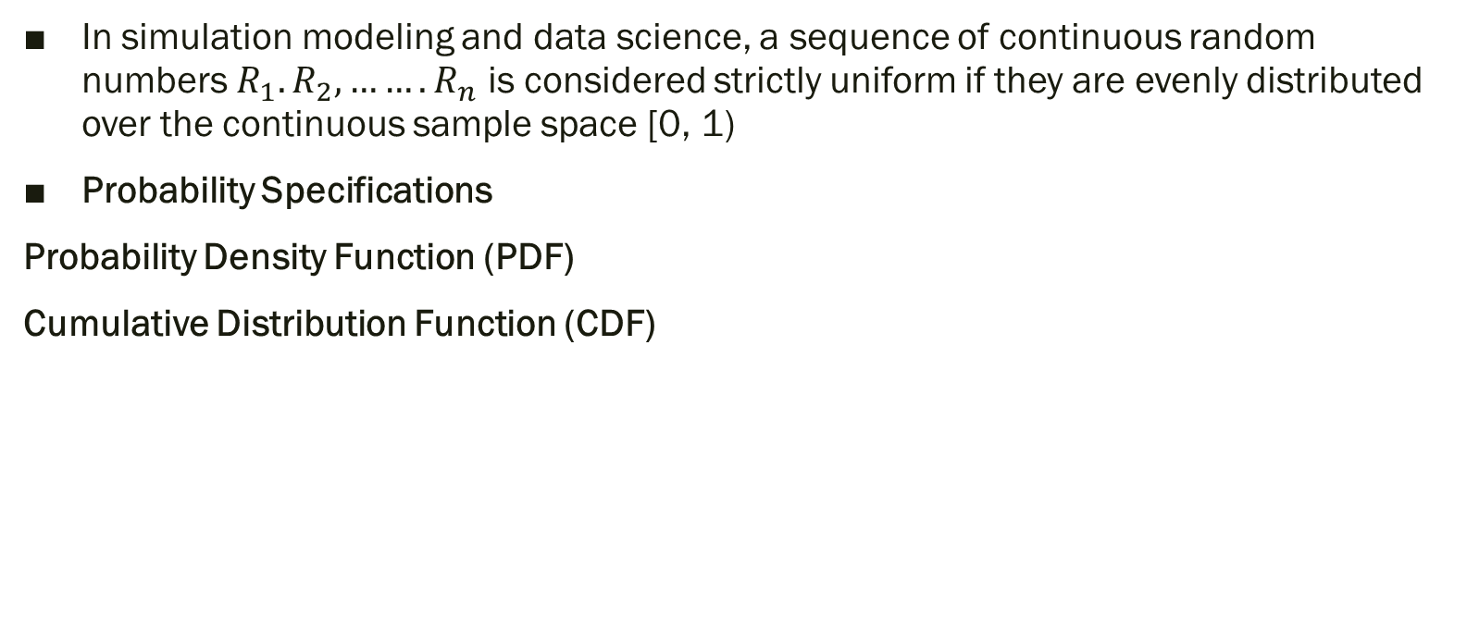
Uniformity Test
In simulation modeling and data science, a sequence of continuous random numbers $R_{1}.R_{2},…….R_{n}$ is considered strictly uniform if they are evenly distributed over the continuous sample space [0, 1)
Probability Specifications
Probability Density Function (PDF)
Cumulative Distribution Function (CDF)

Slide 27
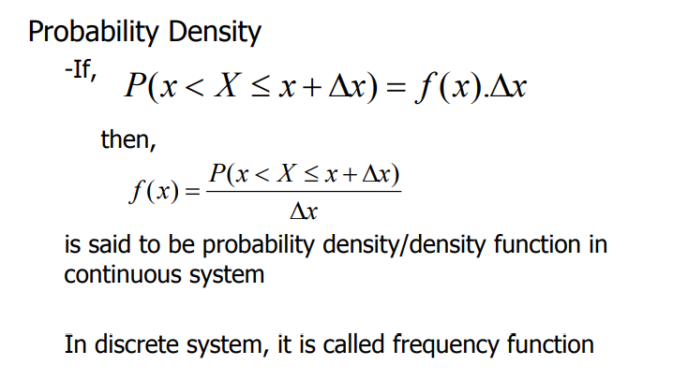

Slide 28
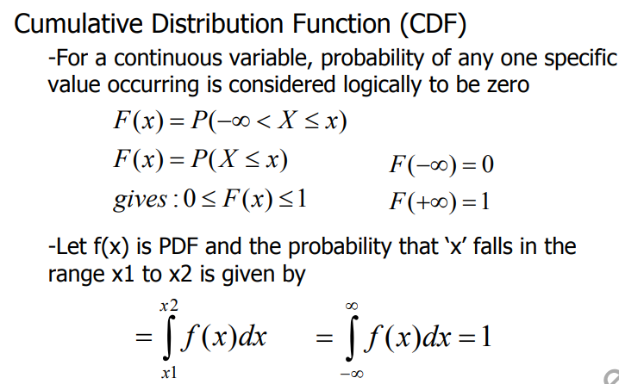
Cumulative Distribution Function (CDF)

Slide 29
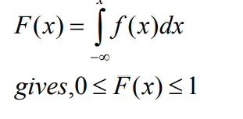
Cumulative Distribution Function (CDF)
-As we have seen already, value of ‘infinity’ is implementation dependent ,But, the cumulative distribution function (CDF) will be
Therefore, probability of x falling in the range x1 to x2 is, F(x2) – F(x1)

Slide 30
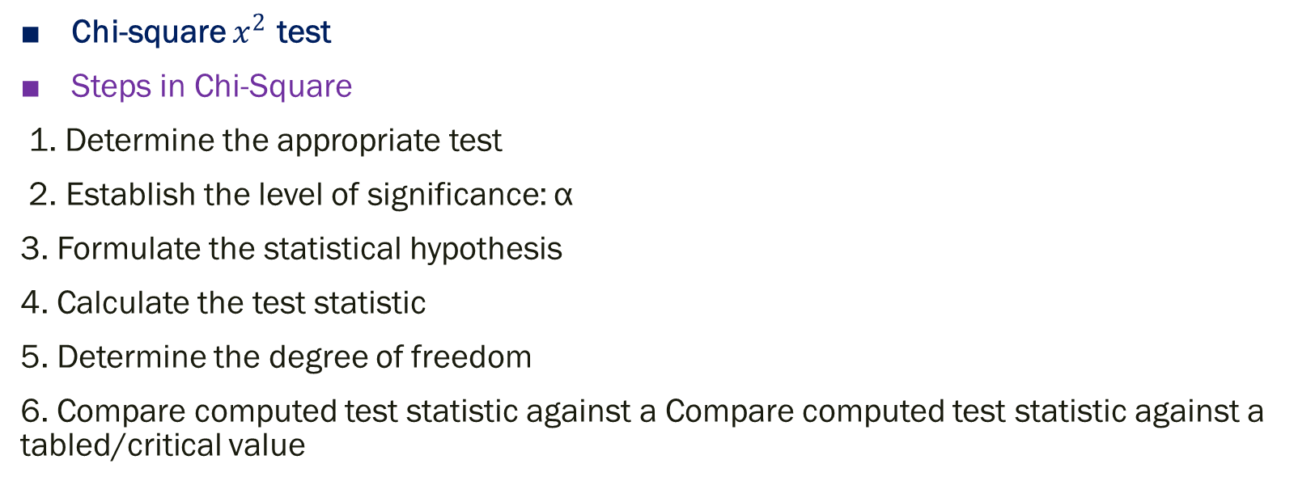
Frequency test
Chi-square $x^{2}$ test
Steps in Chi-Square
1. Determine the appropriate test
2. Establish the level of significance: α
3. Formulate the statistical hypothesis
4. Calculate the test statistic
5. Determine the degree of freedom
6. Compare computed test statistic against a Compare computed test statistic against a tabled/critical value

Slide 31
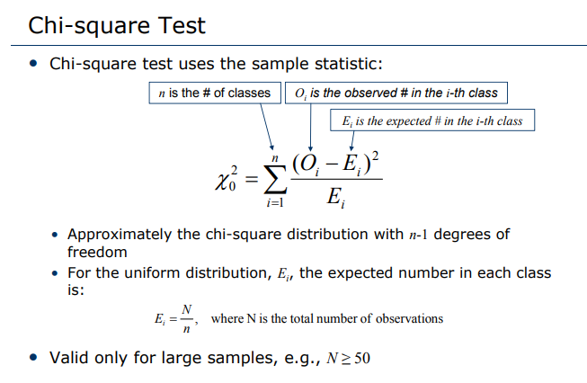

Slide 32
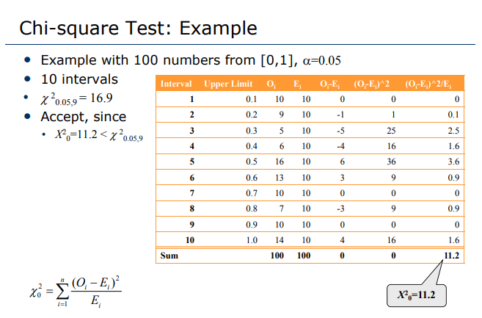

Slide 33
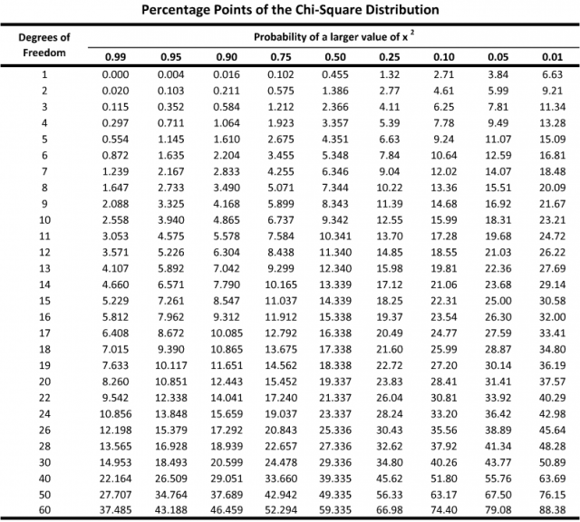

Slide 34
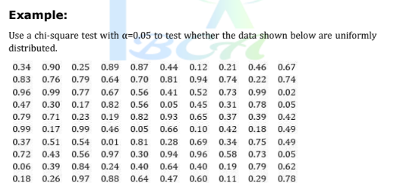
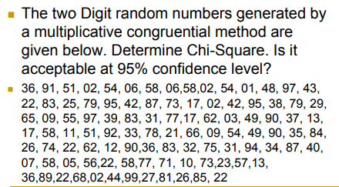

Slide 35
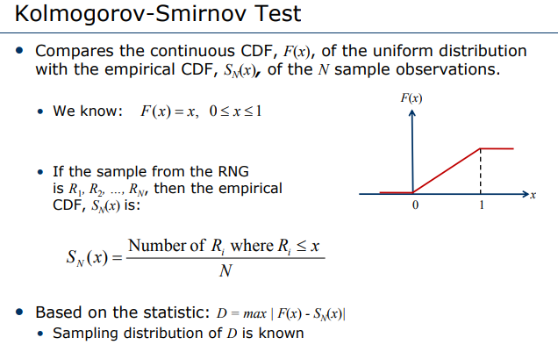

Slide 36
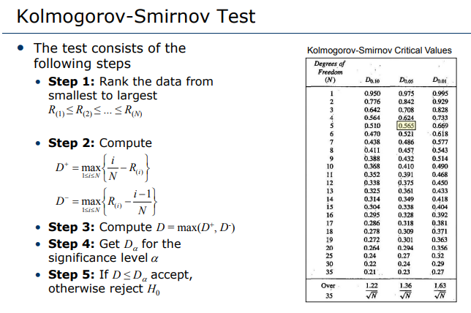

Slide 37
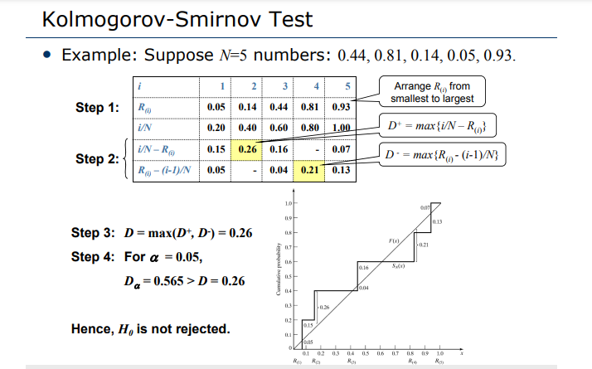

Slide 38
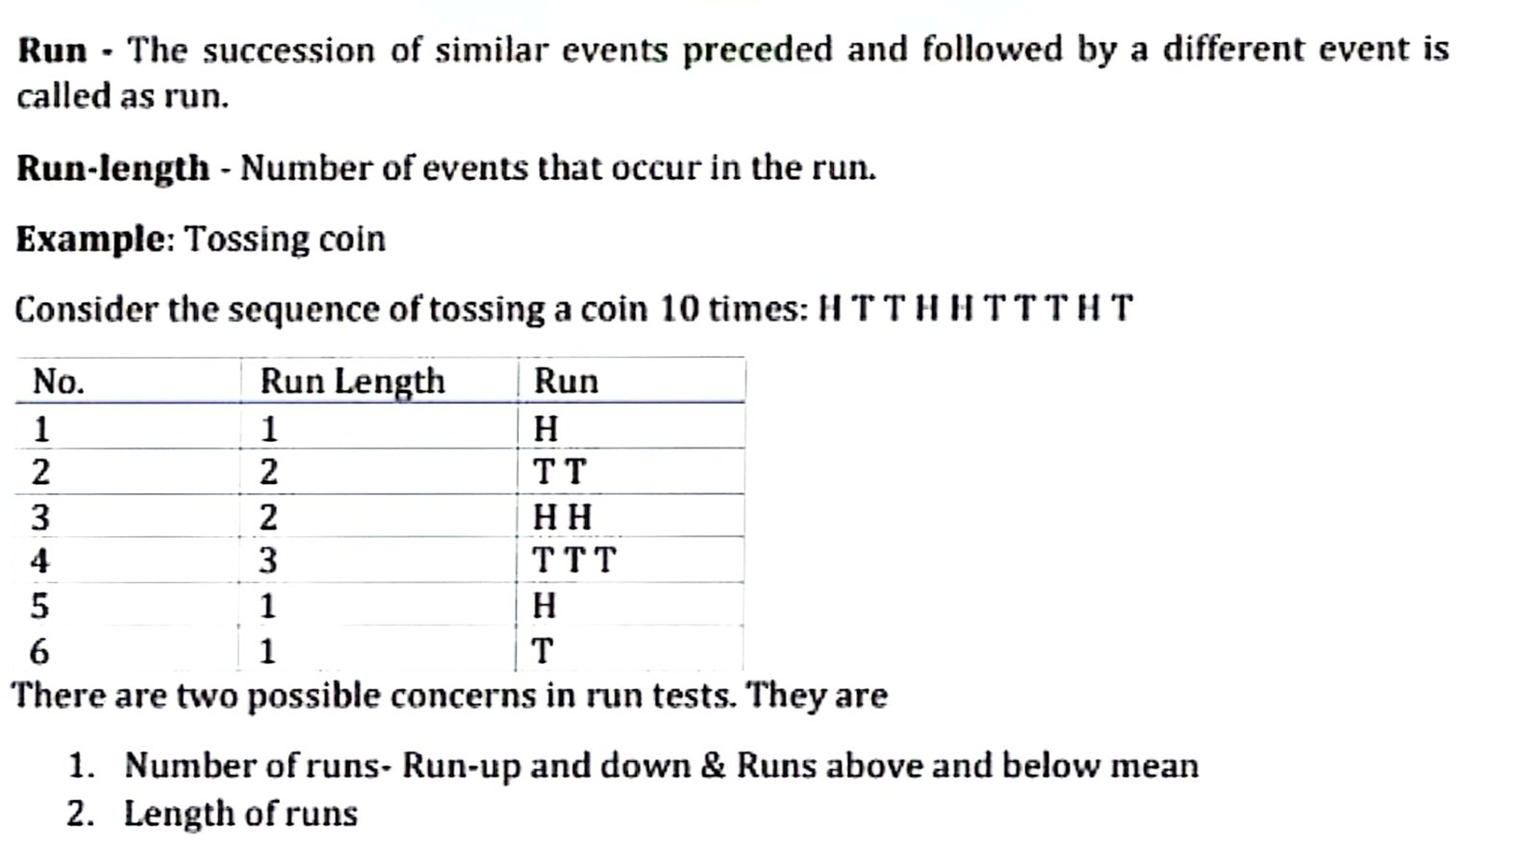
RUN TESTS

Slide 39


Run up and run down
an up run is a sequence of numbers each of which is succeeded by a larger number; a down run is a squence of numbers each of which is succeeded by a smaller number
If a sequence of numbers have too few runs, it is unlikely a real random sequence. E.g. 0.08, 0.18, 0.23, 0.36, 0.42, 0.55, 0.63, 0.72, 0.89, 0.91, the sequence has one run, an up run. It is not likely a random sequence.
If a sequence of numbers have too many runs, it is unlikely a real random sequence. E.g. 0.08, 0.93, 0.15, 0.96, 0.26, 0.84, 0.28, 0.79, 0.36, 0.57. It has nine runs, five up and four down. It is not likely a random sequence.
If a is the total number of runs in a truly random sequence, the mean and variance of a is given by
and

Slide 40
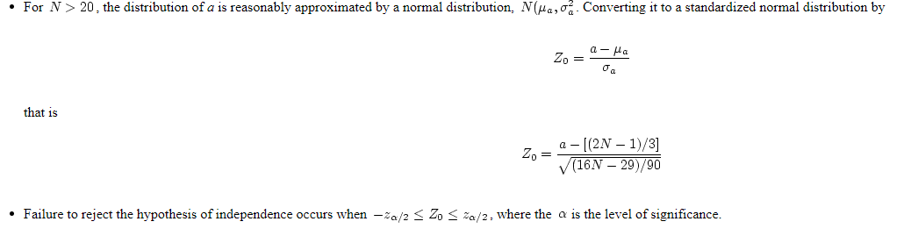
Runs up and runs down

Slide 41
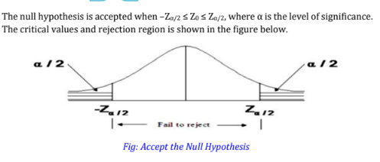

Slide 42
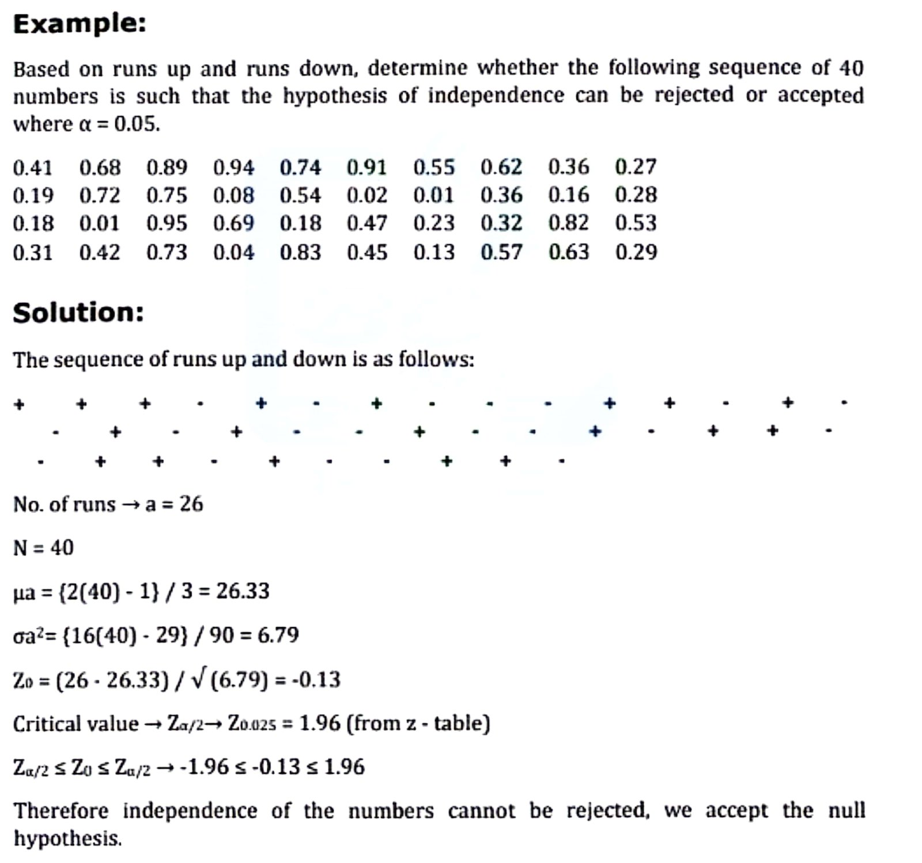
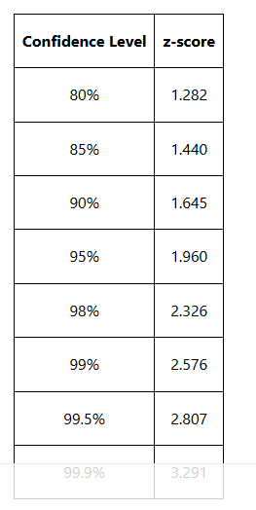

Slide 43
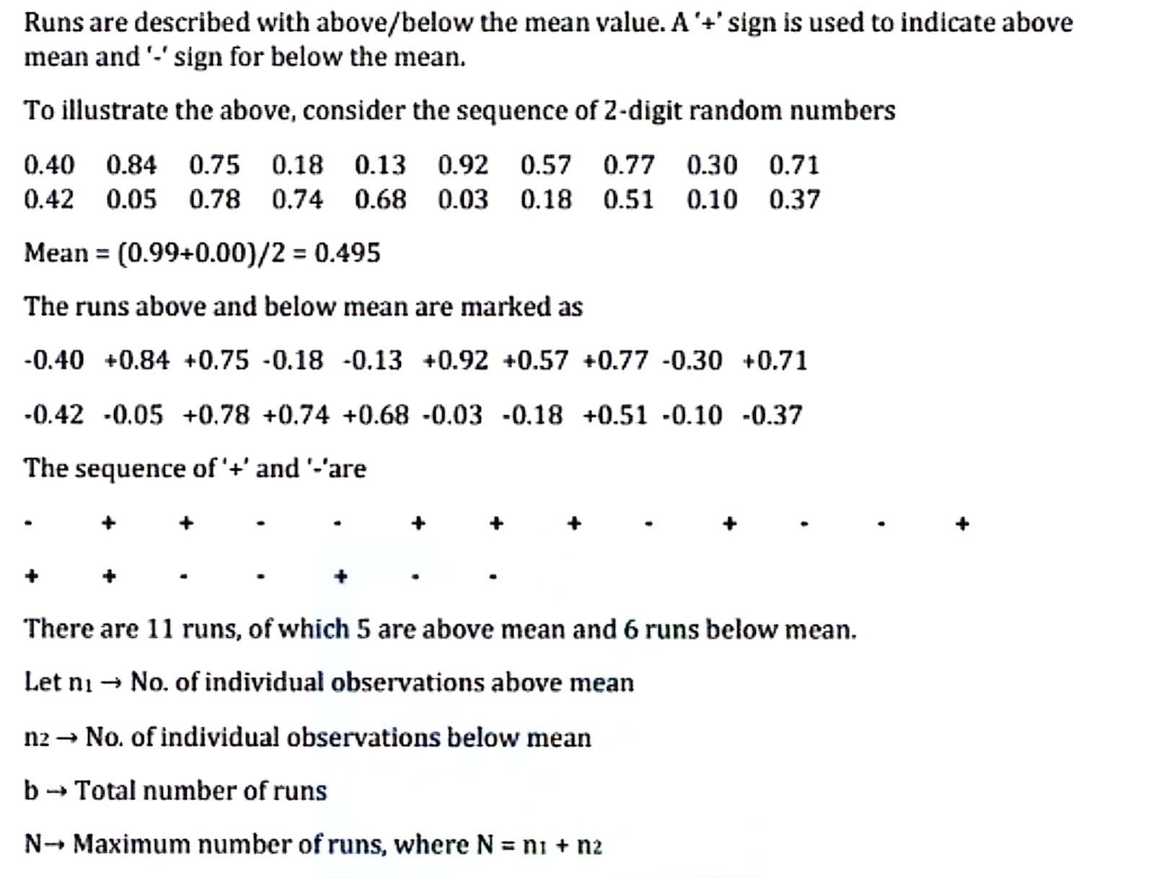
Runs above and below the mean

Slide 44
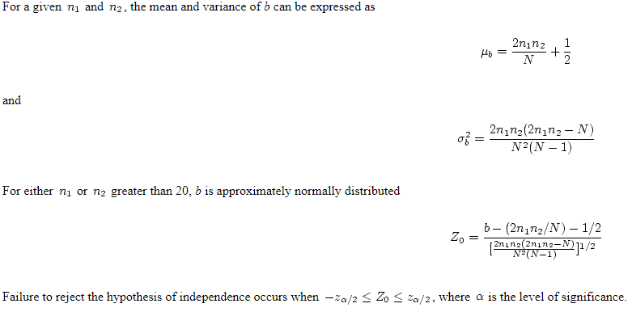

Slide 45
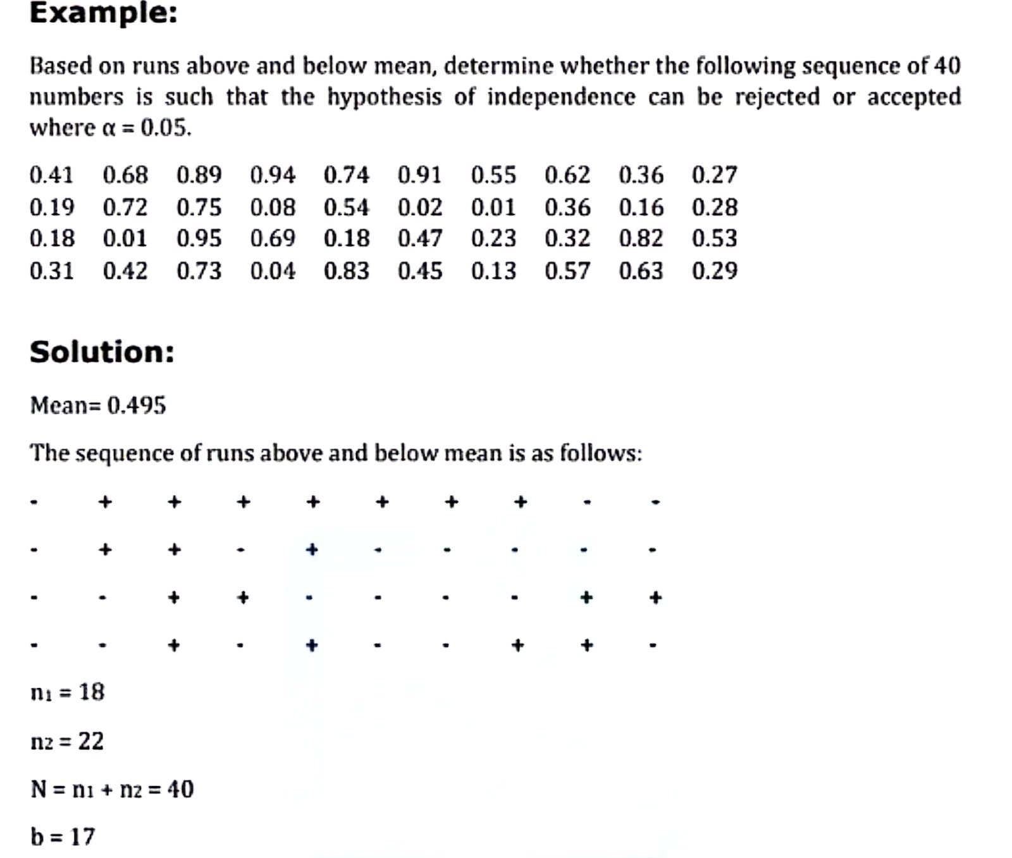

Slide 46
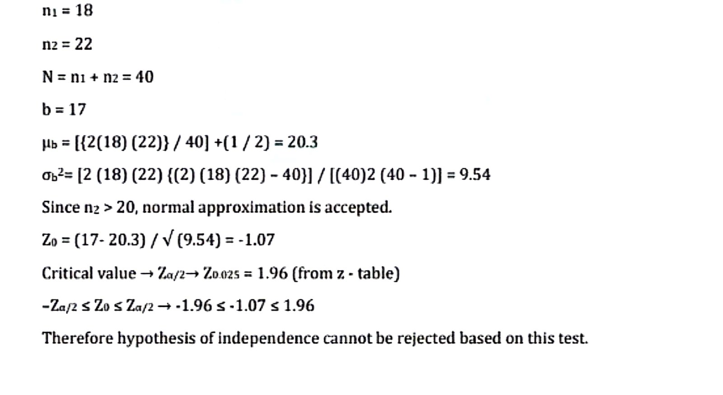

Slide 47
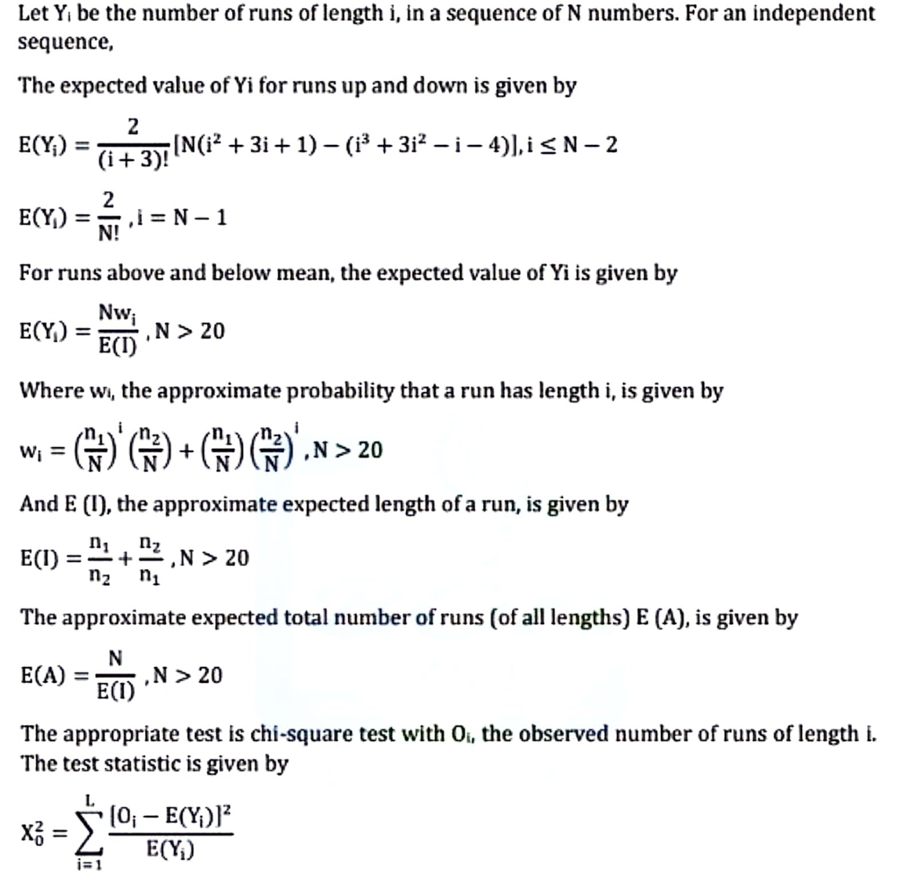
Runs test: length of runs.

Slide 48
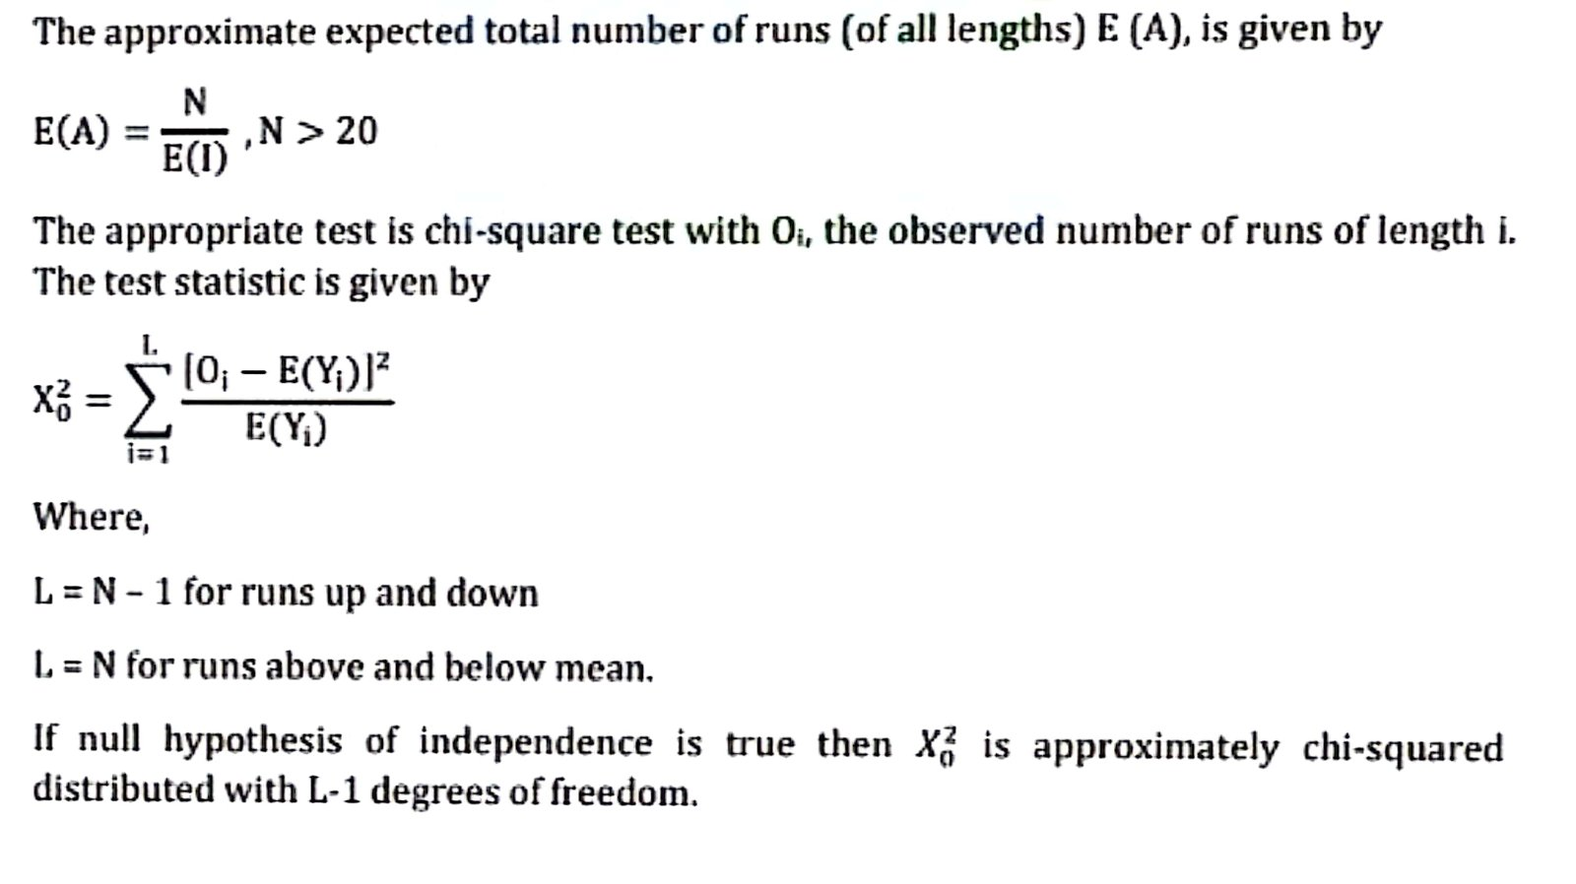

Slide 49
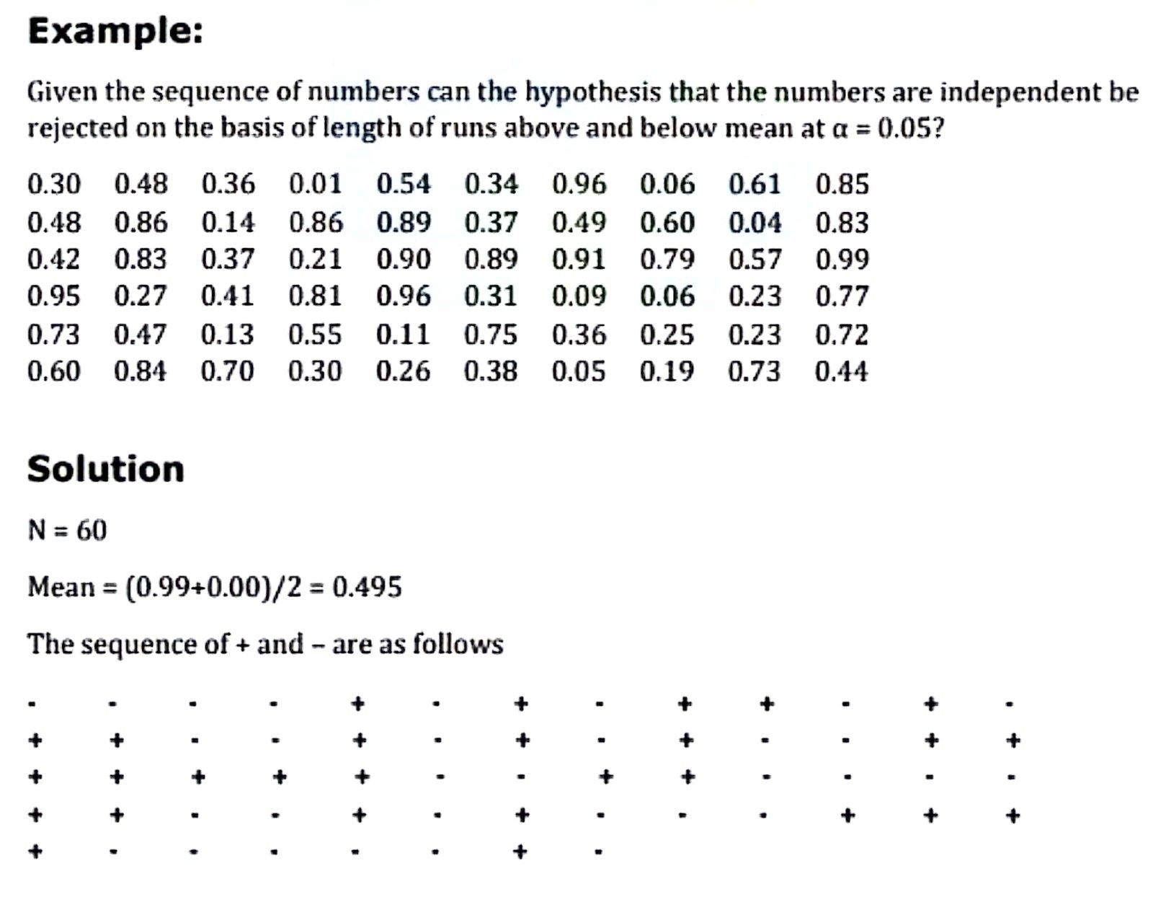

Slide 50
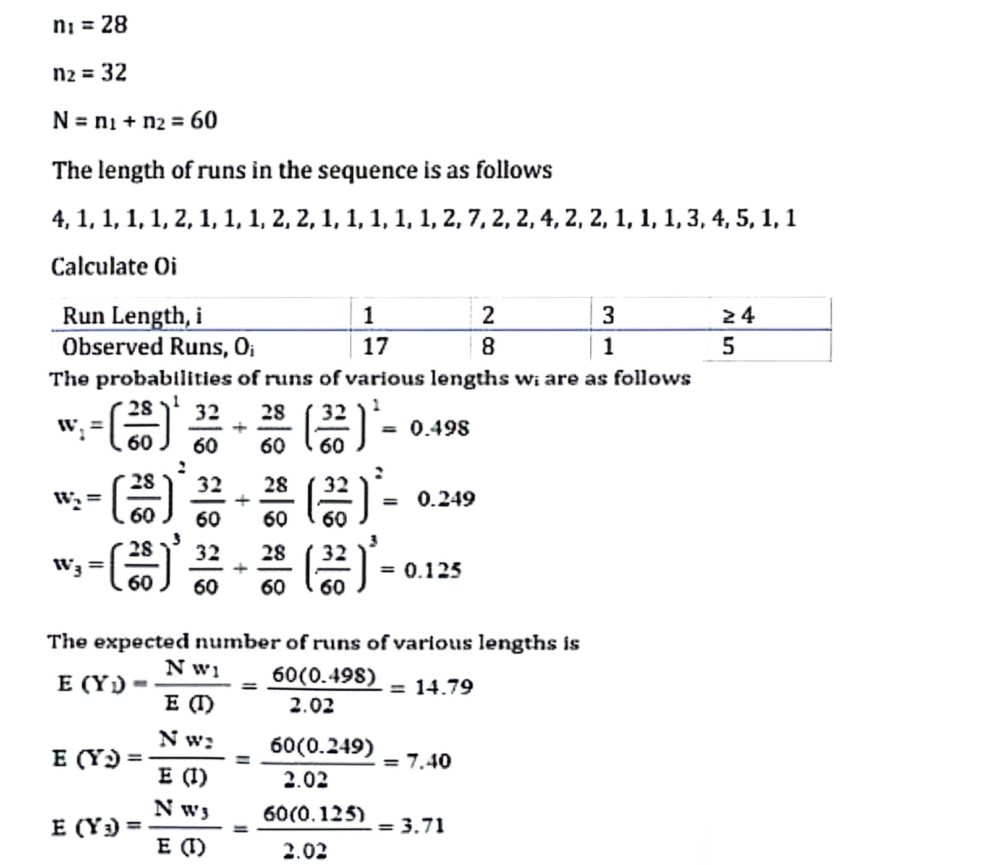

Slide 51
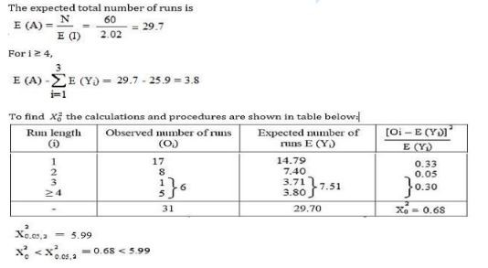

Slide 52
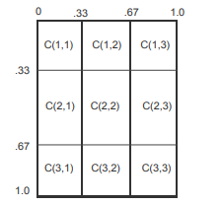
Testing for Auto-correlation
we tested the uniformity of random numbers using chi-square test. But uniformity is essential condition of random numbers, not the sufficient condition. For example if numbers .1, .2, .3, .4, … are tested by chi-square test, they will be hundred percent uniform with chi-square value equal to zero, but numbers have correlation. This means they are not random. This means we need another test for testing the correlation of the random numbers. We device another test so that correlation between two adjoining random numbers is tested i.e., pair of random numbers are to be taken. We check the random numbers in two dimensions. We construct a square matrix say of n×n cells. For simplicity we take n = 3. In this way rows and columns of matrix have size 0.33. Cell(i, j) of the matrix are shown in Fig. 4.5. We chose first two numbers, say R1 and R2. If R1 ≤ 0.33 and R2≤ 0.33, then both numbers lie in cell (1,1) of the matrix. Next we chose second and third number. Same way we test that in which cell both numbers fall. This process is continued till all the succeeding pairs are over. Then we count random pairs in each cell. Expected numbers of pairs in each cell are:
E_{i} = (total number of random numbers – 1)/number of cells
This way frequency Oi of pair in each cell is calculated
Following random numbers have been generated by congruential method. Test their randomness. 49 95 82 19 41 31 12 53 62 40 87 83 26 01 91 55 38 75 90 35 71 57 27 85 52 08 35 57 88 38 77 86 29 18 09 96 58 22 08 93 85 45 79 68 20 11 78 93 21 13 06 32 63 79 54 67 35 18 81 40 62 13 76 74 76 45 29 36 80 78 95 25 52.

Slide 53
Tests for Auto-correlation
The tests for auto-correlation are concerned with the dependence between numbers in a sequence.
The test computes the auto-correlation between every m numbers (m is also known as the lag) starting with the ith number.

Slide 55
Test whether the 3rd, 7th, 11th, and so on numbers in the sequence in the following random number sample are auto-correlated. (Zα=0.05 and Z0.025=1.96) 0.12 0.01 0.23 0.28 0.89 0.31 0.64 0.28 0.83 0.93 0.99 0.15 0.33 0.35 0.91 0.41 0.60 0.27 0.75 0.88 0.68 0.49 0.05 0.43 0.95 0.58 0.19 0.36 0.69 0.87
A sequence of 50 random numbers is generated. You are asked to test whether every 5th number, starting from the 4th number, is independent at a 5% significance level).The Sequence (N=50):0.15, 0.22, 0.91, 0.05, 0.44, 0.38, 0.12, 0.67, 0.82, 0.11,0.29, 0.45, 0.08, 0.54, 0.72, 0.33, 0.19, 0.22, 0.67, 0.81,0.05, 0.44, 0.92, 0.18, 0.37, 0.61, 0.29, 0.84, 0.55, 0.98,0.12, 0.39, 0.76, 0.09, 0.48, 0.63, 0.25, 0.88, 0.91, 0.15,0.34, 0.77, 0.52, 0.64, 0.28, 0.10, 0.93, 0.41, 0.02, 0.59
Type of Movie | Snacks | No Snacks
Action | 5o | 75
Comedy | 125 | 175
Family | 90 | 30
Horror | 45 | 10

